Slide 1
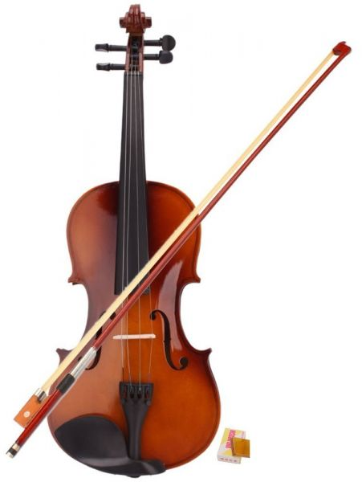
Violin courses
Name: Kirolos Fayek Sabet
Section : IS(4)
GPA : 1.89
Phone : 01226265518
E-mail : kirofayek99@gmail.com
GitHub : https://github.com/kirolosfayek/Violin-Course.git

Slide 2
Description
This website is a fun and comprehensive approach to violin playing for all ages. It is designed for amateur musicians, and the focus of this site is to provide:
Quality instructional material
Easy access to beautiful music
A variety of distance learning options

Slide 3
Functions
Buy violin
Learn:
how to play violin ?
How to repair violin ?
How to read musical note ?
How to play with finger style ?

Slide 4
Technologies
Front end :
HTML
CSS
JavaScript

Slide 5
Platform
Windows
Visual Studio code

Slide 6
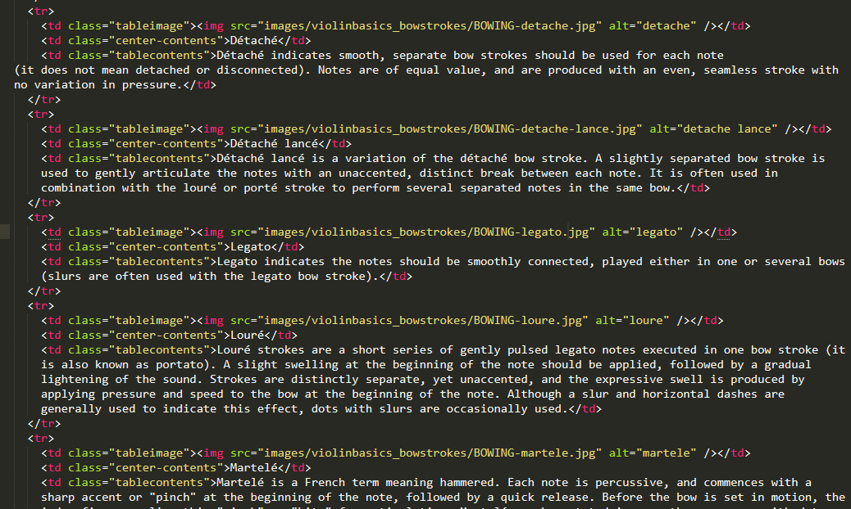
Code screenshots

Slide 7
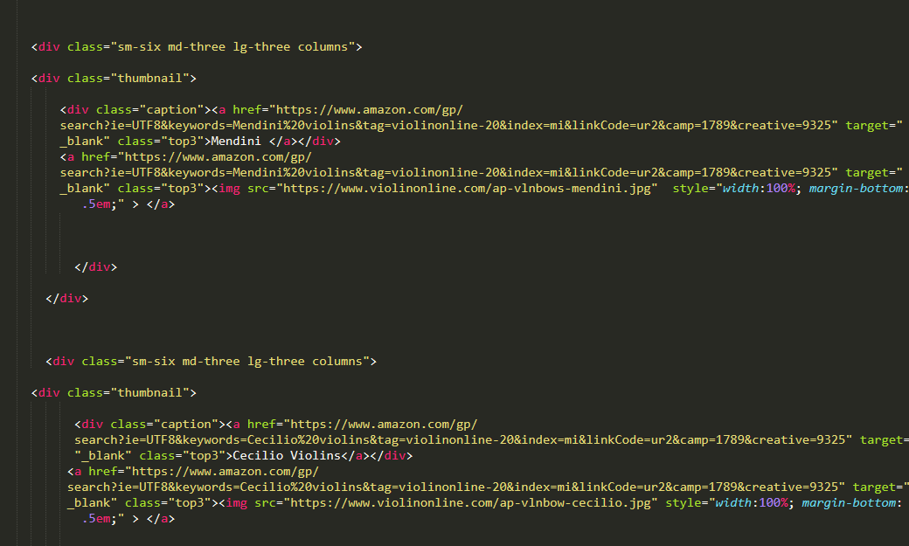

Slide 8
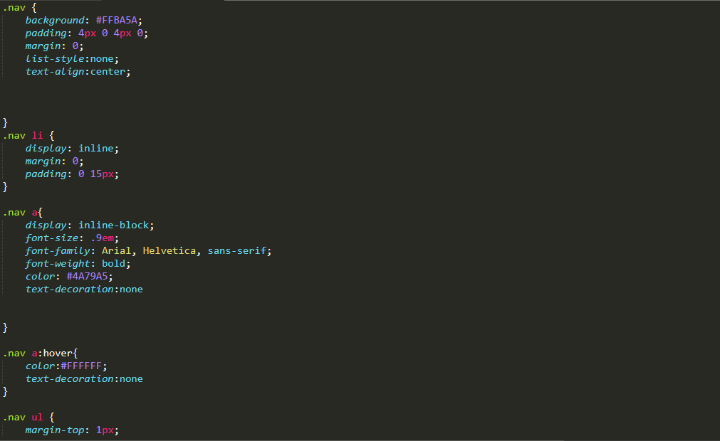

Slide 9
